Slide 1
Machine learning for a 5G future
Md Abdul Mukit ID : IT-17055
Md Abul Bashar ID : IT-17026

Slide 2
Outline
What is 5G?
What will 5G enable?
Introduction of machine learning
Overview of Algorithms in 5G
ML in Networking
ML in Resource management
ML in Mobility
Case Study:ML in SDN for 5G
Case Study:ML in Intelligent Authentication

Slide 3
What is 5G?
5G is the 5th generation of mobile networks, a significant evolution of todays 4G LTE networks. 5G has been designed to meet the very large growth in data and connectivity of today’s modern society, the internet of things with billions of connected devices, and tomorrow’s innovations. 5G will initially operate in conjunction with existing 4G networks before evolving to fully standalone networks in subsequent releases and coverage expansions Characteristics of 5G
Being Deployed all over the world
Based on OFDM
More Bandwith
Network Slicling
Lower Latency

Slide 4
What will 5G enable?
5G will enable instantaneous connectivity to billions of devices, the Internet of Things (IoT) and a truly connected world
There are three major categories of use case for 5G:
Massive machine to machine communications – also called the Internet of Things (IoT) that involves connecting billions of devices without human intervention at a scale not seen before. This has the potential to revolutionise modern industrial processes and applications including agriculture, manufacturing and business communications.
Ultra-reliable low latency communications – mission critical including real-time control of devices, industrial robotics, vehicle to vehicle communications and safety systems, autonomous driving and safer transport networks. Low latency communications also opens up a new world where remote medical care, procedures, and treatment are all possible
enhanced mobile broadband – providing significantly faster data speeds and greater capacity keeping the world connected. New applications will include fixed wireless internet access for homes, outdoor broadcast applications without the need for broadcast vans, and greater connectivity for people on the move.

Slide 5
Machine learning
Supervised
Reinforcement Learning
Unsupervised
Trains the machine using A lebel data set
Example: 1.SVM 2.KNN
Trains the machine without using a label data set
Example:
1.k-Means Algorithm
2.PCA
Trains the machine using Trial and error process
Examples:
1.Deep Inforcement Learning
2.Q-learning

Slide 6
ML in Resource management
Resource management in the context of 5G as the name suggests is a type of management in which resources are organized with each other to minimize the resources.
Two of the main resource management is:
Power Control
Cache Control
Useable Algorithms
SVM
Q-Learning
Convolutional Neural
networks
Useable algorithms
Deep Reinforcement Learninng
Recurrent Neural Networks
Transfer Learning

Slide 7
ML in Networking
In networking we use two algorithoms.those are-
1.Reinforcement
2.Unsupervised learning
We have three fields there we can use those algorithms of ML in networking.Those fileds are-
Bs Switching
Routing
Clustering

Slide 8
ML in Mobility
Machine learning (ML) now a days is considered a silver bullet to solve complex problems and one of the key techniques to enable artificial intelligence (AI) in a wide range of application areas, including autonomous vehicles and wireless communication. Despite great research efforts recently, there are still some open questions that require further attention. Today vehicles are equipped with smart sensors for on-read safety and efficiency. On the other other hand introduction of 5G technologies has made wireless networks faster and smarter than ever before. Full potential of the two can be unleashed if the ML is applied for seamless, reliable and safer connected and autonomous mobility. To what extend it can be applied and how successful it will be is yet to be known. Manuscripts are invited in the following, but not limited to, application areas of ML in relation to connected and autonomous mobility: - 5G communication networks - Semi and fully autonomous vehicles - V2X communication protocols - Localization for connected mobility - Massive MIMO antenna systems and beam forming

Slide 9
Case Study:ML in intelligent Authentication
Helpful in determination of 5G model
What are problems with current existing model
Low Reliability
Different in providing authentication(as more devices are connected)
Prone to Spoofs
Challenge in Determing

Slide 10
Case Study:ML in intelligent Authentication
where can ML help in Intelligent Authentication of 5G?
High Cost
Efficiency
High Realiability
Continuos Protection
Situational Awareness

Slide 11
Case Study:ML in intelligent Authentication
How can we design the ML model for IA?
Parameter Collection
Parameter Analysis
Evolution and Adoption of model

Slide 12
Case Study:ML in intelligent Authentication
Multi-dimensional Attributes are collected
Preference of Statistical Model
Authentication can be improved if we increase the connections between network layer!Thus requiring Mulit-dimensional Attributes
thus leading to a Model-Free Authentication
Parameter
Collection
Physical Layer attributes
WSN network Selection
Mobility Pattern

Slide 13
Case Study:ML in intelligent Authentication
Different ML are applied to observe different behaviours of parameters
Multi-Dimentional parameter may be reduced by using a kernel function
Producing Cost-Effective model
Spoofing can be detected
Regression/Classification is used
Authentication Model Can be validatedto Real –time Situation
Parameter
Analysis
Evolution and Adoption of model

Slide 14
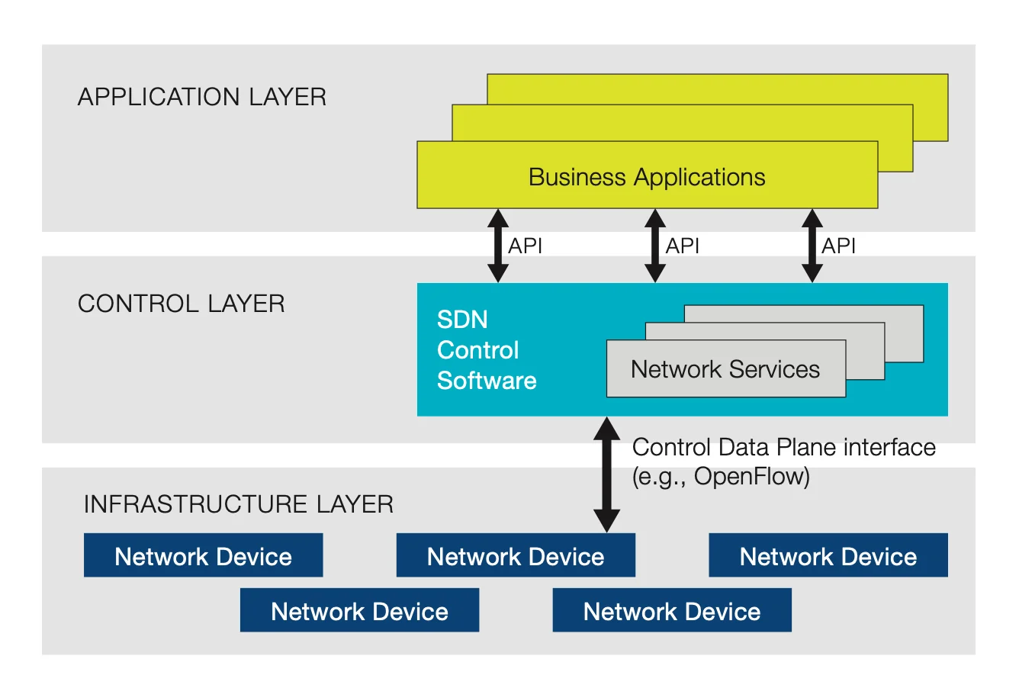
Case Study: ML Anomaly Delection In SDN in 5G
What is SDN?
Software-defined networking (SDN) is an architecture designed to make a network more flexible and easier to manage. SDN centralizes management by abstracting the control plane from the data forwarding function in the discrete networking devices.

Slide 15
ML in Artifical Intelligence
As a scientific endeavor, machine learning grew out of the quest for artificial intelligence. In the early days of AI as an academic discipline, some researchers were interested in having machines learn from data. They attempted to approach the problem with various symbolic methods, as well as what was then termed "neural networks"; these were mostly perceptrons and other models that were later found to be reinventions of the generalized linear models of statistics.Probabilistic reasoning was also employed, especially in automated medical diagnosis.
Machine learning, reorganized as a separate field, started to flourish in the 1990s. The field changed its goal from achieving artificial intelligence to tackling solvable problems of a practical nature. It shifted focus away from the symbolic approaches it had inherited from AI, and toward methods and models borrowed from statistics and probability theory. As of 2019, many sources continue to assert that machine learning remains a subfield of AI. Yet some practitioners, for example, Dr Daniel Hulme, who teaches AI and runs a company operating in the field, argues that machine learning and AI are separate.

Slide 16
Conclusion
There Are multiple types of 5G technology that will be deployed by the various carries,but in short,the technology is all about much larger slices of available spectrum and massive scale in capacity.Machine learning paves the way to get the benefits of 5G communication through its various applicable algorithms .So in near future ,we can get a wireless communication that are more faster and has a low latency by using the various applications of machine learning and that will help to make our real life easy and comfortable

Slide 17
THANK YOU

